Slide 1

Lab Exercise 1 : Serverless Computing and S3 Storage
Dr Phalachandra H.L
Prof. Venkatesh Prasad
Cloud Computing Student TAs

Slide 2
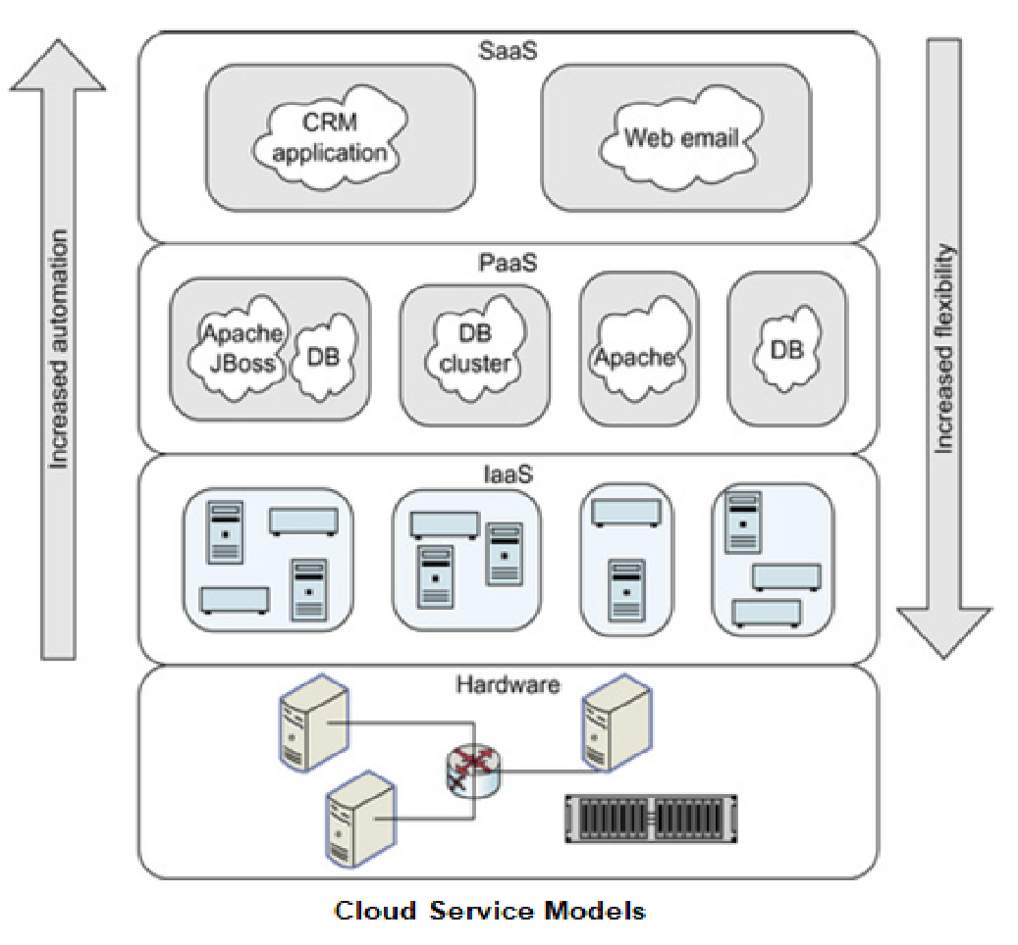
CLOUD COMPUTING
Cloud Computing Service Models
We have looked at the following Cloud Service Models
Infrastructure as a service (IaaS)
The physical hardware (servers, disks, and networks) is abstracted into virtual resources and allocated
Platform as a service (PaaS)
Provides a platform built on top of the abstracted hardware that can be used by developers to create cloud applications Commands provided allow allocation of middleware servers (e.g., a database of a certain size), configure and load data into the middleware
Software as a service (SaaS)
Provides the complete application (or solution) as a service, enabling consumers to use the cloud without worrying about all the complexities of hardware, OS or even application installation

Slide 3
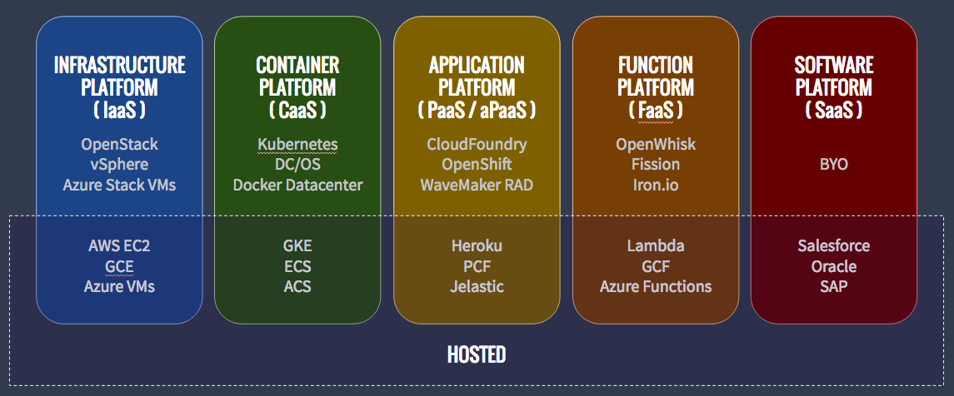
CLOUD COMPUTING
Other Cloud Computing Service Models
There are other Service Models which are also prominently being used like
CaaS (Container as a Service) :
Its a form of container-based virtualization in which container engines, orchestration and the underlying compute resources are delivered to users as a service from a cloud provider.
E.g. Google Container Engine(GKE), AWS (ECS), Azure (ACS)
FaaS (Function as a Service)
It provides a platform allowing customers to develop, run, and manage application functionalities without the complexity of building and maintaining the infrastructure.
E.g. AWS (Lambda), Google Cloud Function
HaaS (Hardware as a Service)
HaaS refers to managed services where computing power is leased from a central provider. If you look at an EC2 instance you will see the HaaS being mentioned there. Eg. EC2 is also a HaaS

Slide 4
Serverless Computing/Function as a Service
Serverless computing (synonymously used as FaaS although there is a school which believes FaaS has even more reduced overheads than Serverless)
In this model, the user is abstracted further from any infrastructure requirement although the Servers still exist on the cloud service provider’s (eg: AWS) side, but it is no longer the user/developer’s responsibility to manage.
You can simply deploy and run code/web application or a Function without provisioning or managing or configuring the infrastructure. Simply write and upload the code or container image and you are done.
The cloud service provider executes the program on behalf of the user and manages the servers.

Slide 5
Serverless Computing/Function as a Service (Cont.)
This reduces the cost for service users further (than proprietary hosts, IaaS, PaaS) by paying only for the compute time utilized for running the application—by per-millisecond—instead of provisioning infrastructure upfront for peak capacity.
Optimize code execution time and performance with the right function memory size.
Typically used with microservices where the microservices can be separate FaaS functions and are targeted for event driven architectures.
Autoscales automatically by spinning up more instances of the program as demand increases.
No resources are allocated when the program is not in use.

Slide 6
AWS Lambda
Serverless computing offered by AWS
Users create self-contained applications(“functions”) in any of the supported languages and provide it as a zip file.
AWS will take care of execution and server management in exchange for money.
Users do not have to care about servers
You can perform calculations, serve web pages, process data streams, or integrate lambda with other AWS services.
Each lambda function is run as a container, which is allocated RAM and CPUs at initialization.
Users are charged based on this allocation multiplied by the time the function runs for.

Slide 7
Other topics or concepts used in the experiment

Slide 8
Other Concepts
So what is object storage Object storage, also known as object-based storage, is a is a data storage architecture for handling large amounts of unstructured data. This is data that does not conform to, or cannot be organized easily into, a traditional relational database with rows and columns. This is another form of storage beyond the block or file and is effective for unstructured data and typically identified by an Id and has meta-data to describe it. In amazon S3, this is available as a bucket (for visualization only like a folder) stores data as objects and its metadata. A more detailed overview will be provided in the upcoming units.
Amazon S3
Simple Storage Services (S3 cause 3 "S“s) is an object storage service that offers industry-leading scalability, data availability, security, and performance in buckets.
This is used for storing the image before the scaling function and post scaling

Slide 9
References
https://en.wikipedia.org/wiki/Serverless_computing
https://en.wikipedia.org/wiki/Serverless_Framework
https://aws.amazon.com/lambda/
https://www.serverless.com/aws-lambda/
https://www.cloudflare.com/en-in/learning/serverless/glossary/serverless-vs-paas/
https://www.cloudflare.com/learning/serverless/glossary/platform-as-a-service-paas/
https://docs.aws.amazon.com/elasticbeanstalk/latest/dg/environments-cfg-autoscaling-triggers.html
https://docs.aws.amazon.com/elasticbeanstalk/latest/dg/using-features.managing.as.html
https://docs.microsoft.com/en-us/azure/architecture/best-practices/auto-scaling
https://aws.amazon.com/s3/
https://www.netapp.com/data-storage/storagegrid/what-is-object-storage/
https://searchaws.techtarget.com/definition/AWS-bucket

Slide 10
Thank you

